Slide 1
Road to CodeMania
Introduction to algorithmic programming
Presented by: Suren S.
Notes:
I’m suren, and I’ll be conducting the fourth session of road to codemania webinar series
Todays session will give you an introduction to algorithmic programming and the competition associated with it.
So, if you’re a beginner who is interested in problem solving and if you would like to get in algorithms, I hope that this session will provide you the foundation knowledge that is required.
The structure of this session will be like this…
I’ll give you a basic introduction to algorithmic programming,
Then we’ll discuss a few problems, their structure, and the solutions… Of course there are many algorithms, and I cant even cover a miniscule of them within this 2 hour session , however, I hope I could introduce you to them so that you wouldn’t feel overwhelmed at first sight, and hopefully I could kindle your interest for you to learn by yourself.
Ok, so after discussing a few problem, I’ll talk about some algorithmic programming competitions, and how you could participate in them, and what kind of skills you would need to succeed in them.

Slide 2
WHAT is algorithmic programming
Algorithmic + Programming
Notes:
As the word suggests, there are 2 parts to this

Slide 3


WHAT is algorithms
Algorithmic Programming
Simple problem
Complex problem
Notes:
Algorithm : Set of well defined steps which could be used to solve a problem.
It’s just like cooking a recipe.
For ex, Baking a cake…. Ingredients (input).... Cake(output).... And there are steps to convert this from input to output. (procedure)....
Simple problems : Find average and rank in class
Complex problem : Plan your travel across the US to be efficient.
For any problem

Slide 4

WHAT is programming
Algorithmic Programming
Notes:
Program is the process…. in which you direct the computer to do a certain task…. Using command which the computer can understand.
The commands which the computer understands…. Called programming languages.
There are different types of programming languages - Web development, App development, Low level programming, High level programming
However, to solve problems - algorithmic problems…. through programming we have a fixed set of languages which can be used
C, C++, Java, Python, Go, etc.
Javascript, PHP (Uncommon)

Slide 5
WHAT is algorithmic programming
Algorithmic Programming
Solving particular problem using an algorithm which is implemented through a computer program
Notes:
Solve particular problem using algorithm through a computer program

Slide 6
WHAT is algorithmic programming problem
Characteristics
Deterministic optimal solution
Well defined system
Objectives
Obtain the optimal solution.
Solve the problem faster.
Resource efficient solution
Notes:
Next question is what kind of problem are these?
First, these have certain characteristics -
Almost always have an optimal solution
System is well defined
Next you have certain objectives:
Optimal solution (it has one)
Obtain the solution fast
Obtain it while not using much resources
We’ll discuss their meaning next

Slide 7
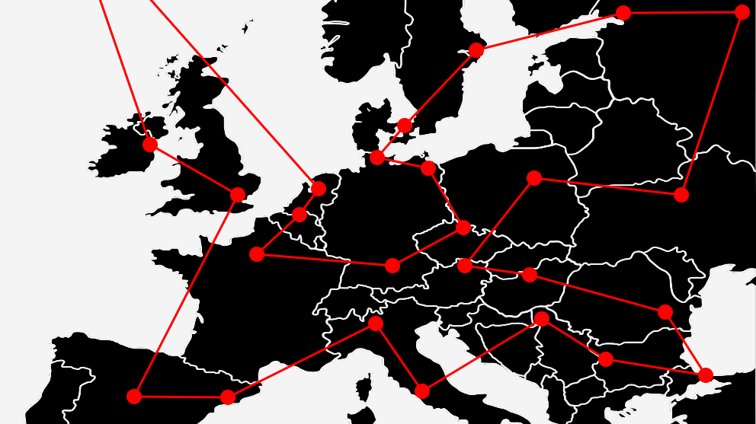
Algorithmic problems - Characteristics
Deterministic optimal solution
Best solution / Non-heuristic.
Problem can be brute-forced.
Well defined system
Inputs, Outputs, Constraints are known.
System is closed and controlled.
Notes:
Hash code
Not for real world problems

Slide 8
Algorithmic problems - Objectives
Obtain the optimal solution.
Solve the problem faster.
Time complexity of solution - Algorithm
Resource efficient solution
Space complexity of solution - Data Structure
Notes:
Already explained the optimal solution. Near optimal would most probably be zero, except some questions
Faster : This depends on the time complexity of the solution, which depends on the algo.
Resource efficiency : Depends on the space complexity of the solution, which depends on the DS.
Although mentioned separately, they’re interconnected.
Rather than explaining this separately, it would be better to learn through a problem.

Slide 9
Find the SUM!
Recursion
Hints
https://www.hackerrank.com/road-to-codemania-v2
Notes:
The first question is the find the sum problem. And you’ll be learning a methodology called recursion.
I hope you have the link… but if you don’t just take a look at this here….
Also, you might have a lot of questions, but to keep up with the schedule, i’ll keep on continuing my presentation.
But please post all your questions, either in the chat, or the discussion of the question…. I’ll show you where it is… and we could discuss them at the end.
So before we start with the question i’ll give you a basic idea about hacker rank, the platform we’ll be using today.

Slide 10
Find the SUM!
0 |  | p |  |  |  | q |  | N-1
x Q queries
Find the sum of elements between indices p and q
Notes:
First read question, discuss input output, constraint
The question is pretty simple… we need to find the sum of elements between indices p and q
Next -> What is the soltuion

Slide 11
Find the SUM!
0 |  | p |  |  |  | q |  | N-1
x Q queries
Find the sum of elements between indices p and q
0 |  | p |  |  |  | q
tot = 0
Notes:
The straight forward solution is also simple…
We start with total 0… and then iterate through the list and add all values to this variable
Next -> Next if I’m going to write the pseudocode for this….

Slide 12
Find the SUM!
0 |  | p |  |  |  | q |  | N-1
x Q queries
Read integers N , Q
Read list A
For each query Q
Read integers p , q
answer = sum_arr ( A, p, q )
?
Notes:
Next -> Next if I’m going to write the pseudocode for this….
First we read the input N, Q and A
And then for each query…
We get 2 more inputs….
After reading all the inputs… we can find the answer using this function caller sum arr… which we should define

Slide 13
Find the SUM!
0 |  | p |  |  |  | q |  | N-1
x Q queries
Read integers N , Q
Read list A
For each query Q
Read integers p , q
answer = sum_arr ( A, p, q )
function sum_arr (A, p, q)
Initialize total = 0
for each element i in A => p : q
total = total + i
return total
Note : Always use built-in function if possible
Notes:
As I said, Easiest way to do this is through a for loop, where you iterate through every elements and find the sum
Actually code this next in hacker…. This is the only one which I’ll be doing and submit… show submissions, leaderboard, discussion, etc.
Note : sum function
Next we’ll see why this happened and how we can solve it

Slide 14
Find the SUM!
Time - Q x (q-p) -> O(Q x N)
Mem - N + 1 -> O(N)
Time - q - p -> O(N)
Mem - 2 -> O(1)
N size list
Read integers N , Q
Read list A
For each query Q
Read integers p , q
answer = sum_arr ( A, p, q )
function sum_arr (A, p, q)
Initialize total = 0
for each element i in A => p : q
total = total + i
return total
p-q iterations
Q iterations
Notes:
So the time complexity refers to the time taken for the code to run and it can be measured in terms of the number of operation that we do….
And the space comp refers to the amount of memeory that the program uses… is measured in terms of the number of variables we use simultaneously
For instance if we consider this function, then we have 1 operatoin, then p – q iterations and then 1 final operation
As for memory, we use just 2 variables total , and I
Although we can measure it like this, we ususally care about the worst cases when in comes to algorithm…. And this is given by something we call the big O notation.
If you’re a novice… big-O can be confusing,…. So just think about the worst case when it comes to the no. of ops.
So p – q can have a worst case when p is 0 and q is N-1 and as such well have to iterate N times.
Similarly the memory is always fixed and the worst case is 2… so to say that it’s constant we use O(1).
Now coming out of the function if we look at the entire code, then
In time, there are Q queries, where for each query I call the sum_ function…. So,, this particular loop will have approximately Q * N operations in the worst case….
Similarly thought the function uses the 2 variables, its overwritten everytime its called…. So the only mem required is to store the list A… which has N elements.
Now usually in hackerrank… the Time complex / Mem complex cannot go beyond 10^9.
If we look at the constraints we see that time goes way beyond this….
Why does this happen??? There should be a better way right

Slide 15
Find the SUM!
Dynamic programming
Hints
Notes:
The first question is the find the sum problem. And you’ll be learning a methodology called recursion.
I hope you have the link… but if you don’t just take a look at this here….
Also, you might have a lot of questions, but to keep up with the schedule, i’ll keep on continuing my presentation.
But please post all your questions, either in the chat, or the discussion of the question…. I’ll show you where it is… and we could discuss them at the end.
So before we start with the question i’ll give you a basic idea about hacker rank, the platform we’ll be using today.

Slide 16
Find the SUM!
0 |  | p |  |  |  | q |  | N-1
x Q queries
Find the sum of elements between indices p and q
Notes:
First read question, discuss input output, constraint
The question is pretty simple… we need to find the sum of elements between indices p and q
Next -> What is the soltuion

Slide 17
Find the SUM!
Time - Q x (q-p) -> O(Q x N)
Mem - N + 1 -> O(N)
Time - q - p -> O(N)
Mem - 2 -> O(1)
N size list
Read integers N , Q
Read list A
For each query Q
Read integers p , q
answer = sum_arr ( A, p, q )
function sum_arr (A, p, q)
Initialize total = 0
for each element i in A => p : q
total = total + i
return total
p-q iterations
Q iterations
Notes:
Now usually in hackerrank… the Time complex / Mem complex cannot go beyond 10^9.
If we look at the constraints we see that time goes way beyond this….
Why does this happen??? There should be a better way right

Slide 18
Find the SUM!
 | p |  |  |  | q
 |  |  | p |  |  | q
p |  |  |  | q
0 | 1 | 2 | 3 | 4 | 5 | 6 | 7 | 8
Notes:
Why does it happen…
So when you consider queries for an example (N =9, Q = 3)
There are multiple values which are recalculated
3-4 * 3, 1-2 *2…. So even in small case, multiple recalculations….
Problem is whether can we optimize this calculation so that you could reuse a once found solution.
Could we “pre” calculate some values, so that we don’t have to do it repeatedly.

Slide 19
Find the SUM!
0 | 1 | 2 | 3 | 4 | 5 | 6 | 7 | 8
Replace sum_arr function with memory element
Notes:
One way is that we can find all the values which need to be recalculated, calculate them and store them….then reuse

Slide 20
Find the SUM!
p
0 | 1 | 2 | 3 | 4 | 5 | 6 | 7 | 8
Replace sum_arr function with memory
sum_arr (A, p, q) sum_A[p, q]
q
sum_A
Notes:
For each p, q pair… we can precalculate all the values….

Slide 21
Find the SUM!
p
0 | 1 | 2 | 3 | 4 | 5 | 6 | 7 | 8
Replace sum_arr function with memory
Problem – N^2
sum_arr (A, p, q) sum_A[p, q]
q
sum_A
Notes:
But, this is not possible because
on one hand “calculating all the recalculated values” is not possible
To calculate these values takes time (N * N)
And storing them like this in a 2d array is not possible because of space (N x N)
So we can see that based on the way we have defined this problem we cannot optimize it….
And If you analyze the reason, we can see that there are 2 vars which vary in N…. leading to N2
So can we redefine this somehow…..

Slide 22
Find the SUM!
p
0 | 1 | 2 | 3 | 4 | 5 | 6 | 7 | 8
Replace sum_arr function with memory
Problem – N^2
sum_arr (A, p, q) sum_A[p, q]
sum_new (A, x) sum_A[x]
q
sum_A
Notes:
So we can see that based on the way we have defined this problem we cannot optimize it….
And If you analyze the reason, we can see that there are 2 vars which vary in N…. leading to N2
So how can do redefine this?

Slide 23
Find the SUM!
sum_arr (A, p, q) sum_new (A, x) = sum (A, 0, x)
 |  | p-1 | p |  |  | q
Notes:
We redefine this by defining a new function sum_new
I can find this and this…. And then say that it’s the difference between the two…
Next -> That iss…

Slide 24
Find the SUM!
sum_new (A, x) = sum (A, 0, x)
sum_ (A, p, q) = sum (A, 0, q) - sum (A, 0, p-1)
sum_ (A, p, q) = sum_new (A, q) - sum_new(A, p-1)
 |  | p-1 | p |  |  | q
Notes:
Once we redefine this function as sum_new…. We can write the previous function in terms of the new function….
Now we have a single valued function…. So… I may be able to memorize these values…. Because I only need O(N) space….
But if I just use sum to calculate the values…. It will be inefficient.
So how do I optimize it for time….
For this… I’m going to use a slight trick which is used in algorithmic programming….
WHICH IS DP…
So in order to use DP….We would usually convert something to a recursive function and then try to use Memoization

Slide 25
Find the SUM! - Recursion
0 |  |  | x | x+1
tot = 0
?
sum_new (A, x+1) = sum_new (A, x) + A [x+1]
sum_new (A, q) = sum_new (A, q-1) + A [q]
sum_new(A,3)
sum_new(A,2)
sum_new(A,1)
sum_new(A,0)
Notes:
First how would I covert to recursion
We noticed that we calculate the sum upto certain point by initializing total to 0, and then adding consecutive values to it.
Now by this idea, We can say that its the sum upto x+1 point = sum upto x point + the x+1 value.
This is a recursive function, where a function calls itself.
Now if you go to the previous example, we had 2 terms….And we can replacef that with this…. We’ll just have one varialbe
One more thing…. As you can see, the function keeps on calling itself… but there should be a point at which they stop
For ex… if I call sum_new(A, 3)
sum_new(A, 0) is sum upto the 0th element..which we know exists, and is the value of 0th element… However, sum_new (A, -1) does not exist… so its 0..
This is called the base case… and if youre familiar with recursion you may know it already

Slide 26
Find the SUM! - Recursion
0 |  |  | x | x+1
tot = 0
?
sum_new (A, q) = sum_new (A, q-1) + A [q]
sum_new (A , 0) = A [0]
Recursion
Base case
Notes:
So this is how we define this recursive function…. With the function call and base case…

Slide 27
Find the SUM! - Recursion
0 |  |  | x | x+1
tot = 0
?
function sum_new (A, x)
if x < 0, return 0
else return sum_new (A, x-1) + A[x]
Notes:
Pseudocode
I said that x = 0 is defined and anything below that is not… so I’ll make them 0
Still, this recursion is going to go at O(n)... so we use a trick called dynamic programming….
I’ll explain it in detail next, but what we do here, is that we precalculate everythin we need and store it so that we can refer to it later

Slide 28
Find the SUM! - Memoization
0
A
sum_A
sum_new (A, 0)
sum_new (A, 1)
sum_new (A, 2)
Notes:
Instead of a recursive function , we store each value in a list….. This is called Memoization
The blue list is the list A
Whereas red list contains sum upto a particular position
For instance sum upto 0th element is just 0th element… so we put it here
Sum upto 1st element is 0 and 1… so we take that sum and put it here..
and then A2…. Over here
Now if we store all these values… instead of going for a recursive call, since we have already stored them in the memory, we could just use them.
How do we do this efficiently… if we just call sum to get all the values, it may still be inefficient ….
Ie in term of time…. Its O(N x N)
For that we can use the idea from before

Slide 29
Find the SUM! - Memoization
0
sum_new (A, q) = sum_new (A, q-1) + A [q]
sum_new (A , 0) = A [0]
sum_new (A, 0)
sum_new (A, 1)
sum_new (A, 2)
Notes:
For this we can reuse the idea of recursive function from earlier…..
We will start with the base case

Slide 30
Find the SUM! - Memoization
0
sum_new (A, q) = sum_new (A, q-1) + A [q]
sum_new (A , 0) = A [0]
sum_new (A, 0)
sum_new (A, 1)
sum_new (A, 2)
Notes:
First i just take the first element and put it

Slide 31
Find the SUM! - Memoization
0
sum_new (A, q) = sum_new (A, q-1) + A [q]
sum_new (A , 0) = A [0]
sum_new (A, 0)
sum_new (A, 1)
sum_new (A, 2)
Notes:
Next, the recursive function says that the sum upto point x is the sum upto point x-1 + the element x…. And I can just do it as an addition.

Slide 32
Find the SUM! - Memoization
0
sum_new (A, q) = sum_new (A, q-1) + A [q]
sum_new (A , 0) = A [0]
sum_A
sum_new (A, 0)
sum_new (A, 1)
sum_new (A, 2)
Notes:
Similarly, I can keep on going with this until the entire array is filled.
Now we have a new array called sum_A where all the sum_new values from 0 upto N have been calculated efficiently
In terms of time complexity this can be done in O(N) time

Slide 33
Find the SUM! - Memoization
0
function sum_new (A, x)
if x < 0, return 0
else
return sum_new(A, x-1) + A[x]
sum_new (A, q) = sum_new (A, q-1) + A [q]
sum_new (A , 0) = A [0]
function sum_new (sum_A, x)
if x < 0, return 0
else
return sum_A[x]
sum_A
sum_new (A, 0)
sum_new (A, 2)
Notes:
Now if you remember the previous function we wrote recursively, it looks something like the top part.
However, with this idea of dynamic programming, since we have already calculated it, we can just return it from memory
So, whereas the previous recursive function started from x and then went to x-1 and then x-2 and so on to obain the answer… It did about x number of operations
This one only requires one operation.

Slide 34
Find the SUM!
Time - N + (Qx2) -> O(Q)
Mem - N + 1 + N -> O(N)
Time - 2 -> O(1)
Mem - 1 + 1 -> O(1)
Read integers N , Q
Read array A
Calculate sum_A
For each query Q
Read integers p , q
answer = sum_ ( A, p, q )
function sum_ (sum_A, p, q)
return sum_new( sum_A,p) -
sum_new(sum_A, q)
function sum_new(sum_A, x)
if... x < 0, return 0
else... return sum_A[x]
1
N
Q
Notes:
Now if I modify my pseudocode….
So that…
First I precalculated all the sum values
And then I can reuse it when necessary….
the complexities have slightly changes
The sum_A calculation will take N iteration
SO previously the time was N * Q… however, now it has become N + Q, and since Q is higher… in the worst case it takes O(Q)…
However, to get this we have sacrificed some memery… by precalculating the N values which will take N more memory locations.

Slide 35
Find the SUM! - Summary
First brute force
Then find issue – Multi variable
Convert to single variable
DP – Recursion + Memoization (Bottom Up)
Notes:
Beginner, Big-O would be complicated, so just look at them as nhumbers…
So the rule of thumb is that if you try to use do about 10^9 operations or store 10^9 values, your answer would definitely fail
At 10^8 you might solve it, but there is a small chance that it may not succeed.
Summarize : Recursion…. Introduced DP… we’ll discuss in detail a bit later.

Slide 36
Find the SUM! - Hints
Think of complexity as numbers instead of big-O.
Look at constraints to get an idea about the answer.
If you don’t understand the question look at the sample.
Notes:
Beginner, Big-O would be complicated, so just look at them as nhumbers…
So the rule of thumb is that if you try to use do about 10^9 operations or store 10^9 values, your answer would definitely fail
At 10^8 you might solve it, but there is a small chance that it may not succeed.
Summarize : Recursion…. Introduced DP… we’ll discuss in detail a bit later.

Slide 37
Candy crushers
Greedy

Slide 38
Candy Crushers
1 |  |  |  |  |  |  |  | n
x T test case
Sort the students from lowest to highest marks.
Give 1 candy to the student with lowest mark. ( c = 1 )
Then go to the next student
If he / she has higher marks then give one more candy than the previous student. ( c = c+1 )
If not (i.e: same marks) then give the same number of candies. (c)
Notes:
What is the most easy way to approach this problem.
We know that the lowest marked student should get the fewer candies, and as marks increase you need more candies.
Greedy : This is called a greedy algo… where at each step we make a decision greedily searcing for the local optimum, and hope that it takes us to the most optimal solution

Slide 39
Candy Crushers
function candy(A)
Sort(A)
One candy to lowest mark (c=1)
Initialize total = c
for marks m in A except lowest
If m > previous mark:
Add one candy to c
Else… Keep c same
Add c to total
return total
1 |  |  |  |  |  |  |  | n
?
x T test case
Read integer T
For each test T
Read list A
answer = candy (A)
Note : Always use built-in function if possible
Notes:
You might be wondering about this sort function
There are many ways to do this… and I cannot explain it within the allotted time.
But lucky for us, we already have a sort in python. So you could use it.
That being said, sort is one of the most important algorithms to learn, so I do suggest that you take a look.
I will post a link for that in the discussion.

Slide 40
Find the SUM!
Time - T (N log N) -> O(TN log N)
Mem – N -> O(N)
Time - 2N + N log N -> O(N log N)
Mem - 2 -> O(1)
Read integer T
For each test T
Read list A
answer = candy (A)
function candy(A)
Sort(A)
Initialize variables (total, c)
for marks m in A except lowest
If… Else… Then…
return total
N * log(N)
T
N
2N
Notes:
I made the function a bit shorter, so we’ll have space… I’ll just reiterate that...
Do not use memory without reason (Next question)
So next before going to the final question on recursion, we’ll take a short break….
And while you take that break, I will give a short intro about programming competitions as i promised.

Slide 41
Road to CodeMania
Introduction to programming competitions
Presented by: Suren S.
Notes:
This presentation is goin to be on Programming competitions.
I’ll give you an introduction on what they are… the skills you’ll require… and how you could achieve them
A tiny note… that this session is mainly targetted towards sri lankan undergrads… and as such you’ll find most info relevant in a local context

Slide 42
CS competitions
Hackathons
Algorithmic Programming
Datathons
Notes:
3 types of CS competitions
Some students confuse these… so I’ll just clarify this a bit

Slide 43




Hackathons
Product development
Pitch and idea
Demonstrate
www.hackathonsinternational.com
www.hackathons.lk
Notes:
Most common type of competition
These are product dev.
Where you go and pitch an idea usually followed by a demonstration of your idea.
Then you are ranked based on viability, profitability, novelty.
These competitions can be themed as well : in some cases you’ll have to solve a problem in a given domain… for example a biomedical hackathon in sri lanka is brainstorm organized by UoM
There are some hackthons where you’ll have to use a particular technology…. Like the dialog NBIOT hackathon.
However, the overall idea is that you should have an idea for a viable product.
There are many such competitions both locally and internationally.
For local competitions : hackathons.lk

Slide 44


Datathons
Solve a data science problem
Solve task from datasets
Solve addition problems
Notes:
These are competitions in which you’re given a data science problem, and must solve the given problem.
Unlike hackathons, Usually given a predefined problem
In a local context,these are the two competitions organized by universities.
You also have ones organized by entities like the dialog datathon…
Then in an international context you have competitions like kaggle which are much more known.

Slide 45
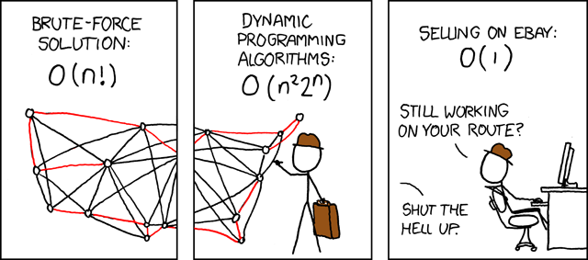
WHAT is competitive programming
Try to solve a problem using computer programs with constraints: Time and memory
First to get the correct results wins.
Notes:
Competitive programming is a competition in which you solve algorithmic problems…
In addition to obtaining the correct solution, you should also make sure that the solution suffices the constraints such as time and memory.
And based on your ability to solve different algo problems, you’ll be given points based on which you will be ranked.

Slide 46
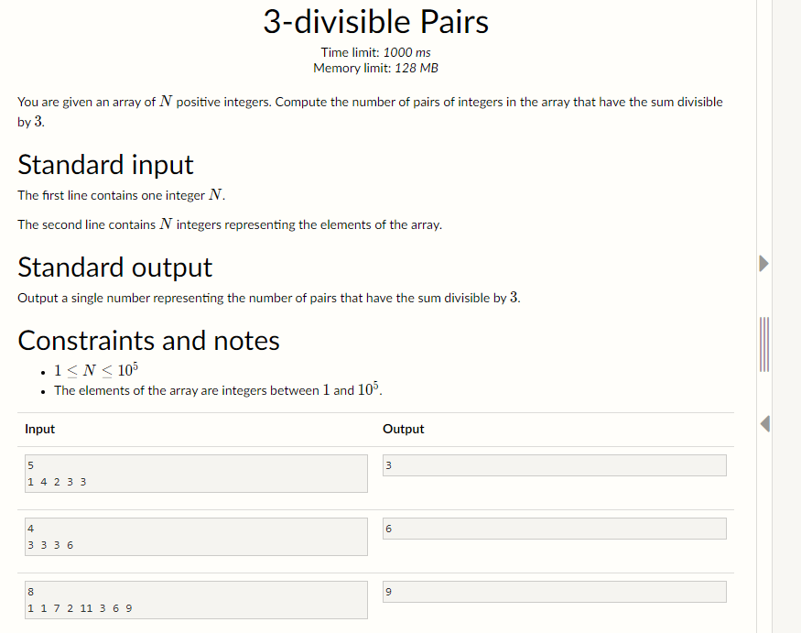
WHAT is competitive programming
Constraints
Problem
If you complete the task you get points
Examples
Notes:
Sample problem from csacademy.com
How a usual problem is presented
For each problem you have a description, the input and the output… You can use this to interpret the problem.
Then you have a set of examples which you could use to understand the problem better… and to test your code.
Finally you will also have some constriants which you must follow while solving the problem
So, By solving several problem, you’ll get some points.. And finally you are ranked based on the points obtained
So this is the geral idea of a competitive programming competition, but the requirements might vary slightly.
Next you might be wondering you I am…

Slide 47
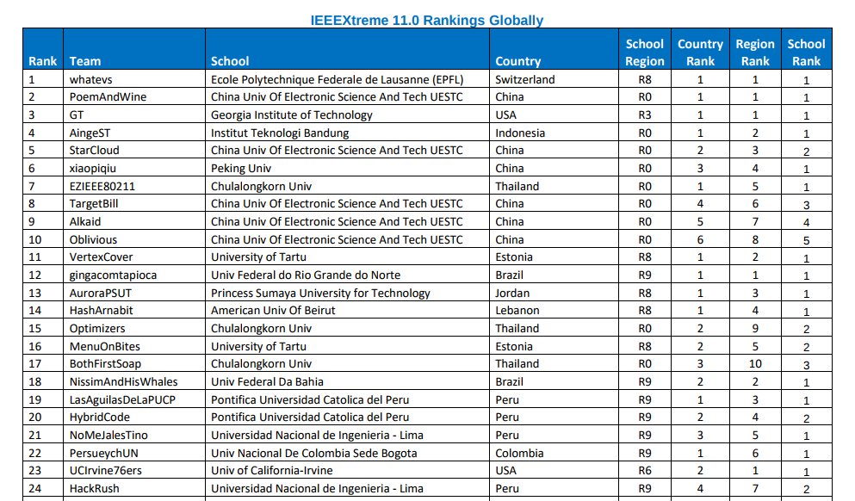
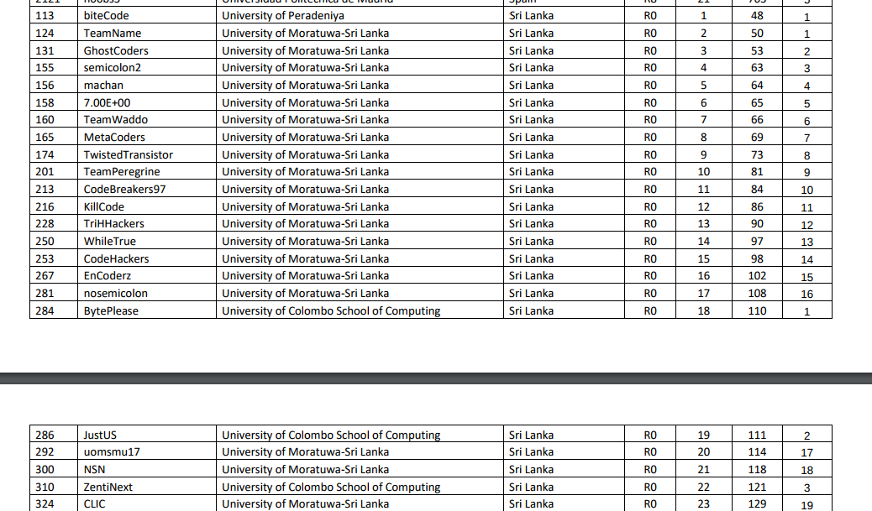
Global rankings
Local rankings
suren3141.github.io
teambitecode.github.io
Notes:
Who am I?
I am an algorithmic programming enthusiast…. And have participated in quite a few coding competitions…
Most notably, in IEEE extreme where teambitecode was placed in the top 2 for 4 consecutive years
This was in 2017, when we came first
If you’d like more info… go to personal github page… at suren3141…. Or the group page at teambitecode.
So even though I’m not an expert, I hope my opinions would be quite helpful to you in the future.
The next few parts are my opinions…. and the opinion of me and few colleagues

Slide 48

WHY participate in competitive programming
Improve problem solving ability
Improve programming skills
Competitive edge when hiring
Awards and recognition
Notes:
Problem solving: Uber - search a ride for the customer efficiency… algo would be a good start
Programming skills: By doing these problems obviously improved
Hiring: Google, FB, common interview questions, Addition to CV
Awards :Local 75k to 100k, Global / Online : Much more (cash prize, items, etc.)
Next, what do you need to know?

Slide 49
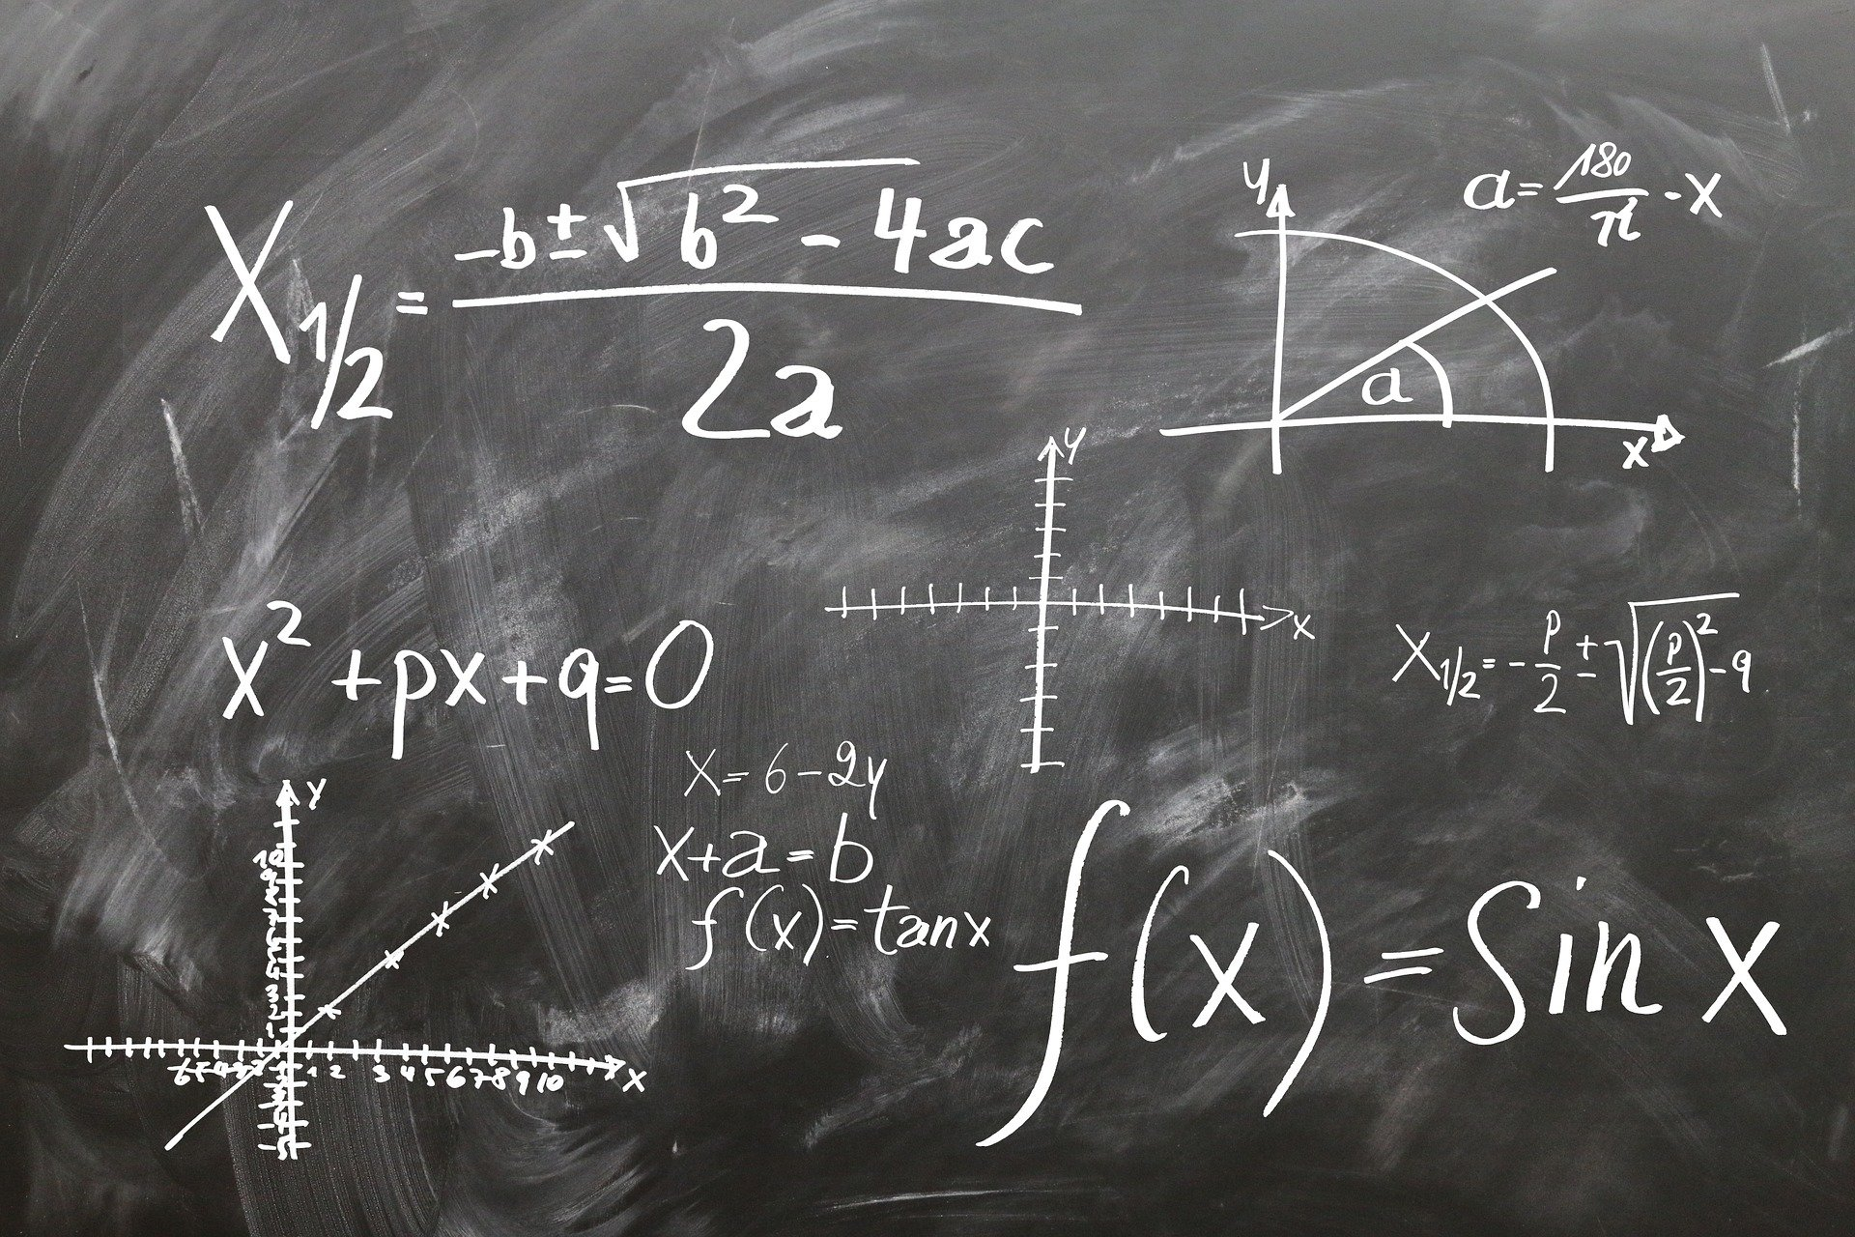


Competitive programming
How to think?
Mathematics
Programming
Creativity
Notes:
What do you need to know?
In general competitive programming is said to be a competition which tests your ability to think … or solve problems.
And it is advertised as a combination of mathematics programming and some creative thinking

Slide 50
What is competitive programming?
Programming 50%
Mathematics 30%
Creativity 20%
Notes:
So most of the competition have these components in various ratios.
The general ratio is something like this…. Depending on the problem setter, this varies
Now even though this is how you expect your skills should be…. The reality is quite different

Slide 51
What is competitive programming?
REALITY
Programming 25%
Mathematics 15%
Creativity 10%
Practice 50%
Notes:
So in reality…. A major component comes from practice.
What you need to succeed in these competitions is rigorous practice.
Once You do enough question from different types of algorithms and once you can train yourself to think in particular way
Then you can be quite a good competitive programmer…
How long should you practice??

Slide 52



WHERE to learn competitive programming
Beginners : Practice
Moderate : Local + online competition
Advanced : Global competition
Notes:
So next how do you practice
When starting something : Overwhelmed with information. So this a a minor guide for the steps you can take to advance.
We can divide this into 3 stages : beginer, moderate and advanced.
So as the first step you practice…. Again and again through different sources and learn about DS and algo, while familiarizing yourself with the questions.
As the next level you could target some good rank in a local competition.
And if you think you can handle that then definitely move onto a global competition.

Slide 53

Popular platforms
HackerRank.com
CodeForces.com
CSacademy.com
ProjectEuler.com
CodeChef.com
TopCoder.com
Notes:
Popular online platforms for both practice and participation...
First to practice:
So what I’m doing now is an intro session , and it’s not structured… But if you’re interested in it, you could easily go to these websites and learn which are structured and would have much better resources.
Can we goto a website and show how easy it is to participate/practice??

Slide 54


Local competitions
ACES coders
MoraExtreme
Notes:
Then there are a few local competitions. These are the famous 2 open to all uni students.
In add

Slide 55

Worldwide competitions
IEEEExtreme
Google codeJam
FaceBook HackerCup
ACM ICPC
Notes:
At last the global competition which is the pinnacle of competitions.

Slide 56
FAQ
Expert in programming ?
NO
Expert in algorithms and datastructures?
NO
Advanced mathematical knowledge?
NO (Preliminary knowledge)
What do you need?
Problem solving skills and practice
Notes:
Finally a few questions asked frequently.
Due to the way they are structured, most people think that to participate in these competitions you would need to be an expeert in programming on algo DS…
But in reality, most of them can be learnt within a short period of time.. OF course there is a learning curve, but if you’re willing to invest some time into this…. You could do this within 3 to 6 months.
So, if you ask a question as to whether you have to be an expert in anything… like alog or programming or mathematics, the answer Is no… You could learn most of them on the way within a shrot time and I’m not only telling this from personal experience, but also from what I’ve seen from a lot of others.
And then there are some who worry about maths… but this is not a place to test your maths skills. SO while you might need simple mathematical knowledge… like upto grade 9 or may OL, you wouldn’t even have anything slightly complicated like diff, integration.
SO what do you actually need is some problem solving skills and the will to learn.
Anyone who is interested and has a will to learn can excel at this even without any prior knowledge,
All you need in some problem solving ability and perseverance… and you could become quite good in about 6 months.

Slide 57
Prime sum
Mathematics in Algo

Slide 58
Prime Sum
0 |  |  |  | i |  |  |  | n-1
x T test case
Find a point i where the sum of primes on the left and right are equal.
Find primes ?
What do we do about non-prime numbers?
Find the sum of elements left and right of a point?
Notes:
What is the most easy way to approach this problem.
We know that the lowest marked student should get the fewer candies, and as marks increase you need more candies.
Greedy : ???

Slide 59
Prime Sum
0 |  |  |  | i |  |  |  | n-1
x T test case
Find a point i where the sum of primes on the left and right are equal.
Find primes ?
What do we do about non-prime numbers?
Find the sum of elements left and right of a point?
Find a function to filter them
Notes:
What is the most easy way to approach this problem.
We know that the lowest marked student should get the fewer candies, and as marks increase you need more candies.
Greedy : ???

Slide 60
Prime Sum
0 |  |  |  | i |  |  |  | n-1
x T test case
Find a point i where the sum of primes on the left and right are equal.
Find primes ?
What do we do about non-prime numbers?
Find the sum of elements left and right of a point?
They shouldn’t have any effect while calculating the sum
Notes:
No effect while calculating the sum… but we can’t remove them as we still need the indexes to be the same…. So we can just make them zero

Slide 61
Prime Sum
0 |  |  |  | i |  |  |  | n-1
x T test case
Find a point i where the sum of primes on the left and right are equal.
Find primes ?
What do we do about non-prime numbers?
Find the sum of elements left and right of a point?
We can use sum_new between (0, i-1) and (i+1, n-1)
Notes:
There are multiple ways of doing this… but we already discussed a easy way using sum_new function from the first problem… But yeah, there are less complicated ways.
Do not use the sum function here…..

Slide 62
Prime Sum
0 |  |  |  | i |  |  |  | n-1
x T test case
Find if a number is prime and if not make it zero.
For each index i between 0 and n-1
If left sum is equal to right sum i is the answer
If not move to the next point
If you reach the end of the list there is no answer (-1)
Notes:
What is the most easy way to approach this problem.
We know that the lowest marked student should get the fewer candies, and as marks increase you need more candies.
Greedy : ???

Slide 63
Prime Sum
function prime_sum(A)
for element x in A
if x is not a prime, make x = 0
calculate sum_A
for each index i from 0 to n-1
left sum = sum_new(sum_A, 0, i-1)
right sum = sum_new(sum_A, i+1, n-1)
if left sum is equal to right sum
return i
return -1
0 |  |  |  | i |  |  |  | n-1
Read integer T
For each test T
Read list A
answer = prime_sum(A)
Notes:
Since we need the first i, this is fine

Slide 64
Prime Sum - Find prime
Prime - A number which has no divisor other than 1 and itself.
So if it's divisible by any other number less than it, then it’s not a prime.
function prime(A) for numbers i between 2 and sqrt(A) if A is divisible by i return False return True
sqrt (N)
Notes:
Since we need the first i, this is fine
Only go upto sqrt N
This is good enough if we need to find if a number is prime… however we’ll have to find multiple primes and this would be very inefficient

Slide 65
Prime Sum
function prime_sum(A)
for element x in A
if x is not a prime, make x = 0
calculate sum_A
for each index i from 0 to n-1
left sum = sum_new(sum_A, 0, i-1)
right sum = sum_new(sum_A, i+1, n-1)
if left sum is equal to right sum
return i
return -1
N
Time - T * N * sqrt(A)
sqrt(A)
N
N
Read integer T
For each test T
Read list A
answer = prime_sum(A)
N * sqrt(A)
Notes:
If we look at the time for this algo….

Slide 66
Prime Sum - Find all primes : Sieve
Sieve - Find all primes upto a number N
Time without sieve = O(N sqrt(N))
Time with sieve = O (N log (log N))
Space without sieve = 1
Space with sieve = O (N)
N = 10^6
NO sieve = 10^6 * 10^3
sieve = 10^6 * 5
Notes:
So to find all primes upto a number N we’ll use a faster method called a sieve…
As you know a sieve is an instrument used to separate solids from liquids, while making tea for instance.
In this case we’ll be separating primes…
It’s comparatively fast… So to find them one by one…
However you’ll have to sacrifice something, in this case its...

Slide 67
Prime Sum - Find all primes : Sieve
function prime(N) Skip 0 and 1 for numbers i between 2 and sqrt(N) if i is not cancelled for numbers j from i² to N in steps of i cancel j
 | 2 | 3 | 4 | 5 | 6 | 7 | 8 | 9 | 10
11 | 12 | 13 | 14 | 15 | 16 | 17 | 18 | 19 | 20
21 | 22 | 23 | 24 | 25 | 26 | 27 | 28 | 29 | 30
31 | 32 | 33 | 34 | 35 | 36 | 37 | 38 | 39 | 40
41 | 42 | 43 | 44 | 45 | 46 | 47 | 48 | 49 | 50
Notes:
So to find all primes upto a number N we’ll use a faster method called a sieve…
As you know a sieve is an instrument used to separate solids from liquids, while making tea for instance.
In this case we’ll be separating primes…
It’s comparatively fast… So to find them one by one… itll take

Slide 68
Prime Sum - Find all primes : Sieve
function prime(N) Skip 0 and 1 for numbers i between 2 and sqrt(N) if i is not cancelled for numbers j from i² to N in steps of i cancel j
 | 2 | 3 | 4 | 5 | 6 | 7 | 8 | 9 | 10
11 | 12 | 13 | 14 | 15 | 16 | 17 | 18 | 19 | 20
21 | 22 | 23 | 24 | 25 | 26 | 27 | 28 | 29 | 30
31 | 32 | 33 | 34 | 35 | 36 | 37 | 38 | 39 | 40
41 | 42 | 43 | 44 | 45 | 46 | 47 | 48 | 49 | 50
Notes:
First loop starts at 2 and goes upto sqrt N… which in this example is sqrt of 50… approx 7. Something…. So we’ll stop at 7

Slide 69
Prime Sum - Find all primes : Sieve
function prime(N) Skip 0 and 1 for numbers i between 2 and sqrt(N) if i is not cancelled for numbers j from i² to N in steps of i cancel j
 | 2 | 3 | 4 | 5 | 6 | 7 | 8 | 9 | 10
11 | 12 | 13 | 14 | 15 | 16 | 17 | 18 | 19 | 20
21 | 22 | 23 | 24 | 25 | 26 | 27 | 28 | 29 | 30
31 | 32 | 33 | 34 | 35 | 36 | 37 | 38 | 39 | 40
41 | 42 | 43 | 44 | 45 | 46 | 47 | 48 | 49 | 50
Notes:
Then the inner loop

Slide 70
Prime Sum - Find all primes : Sieve
function prime(N) Skip 0 and 1 for numbers i between 2 and sqrt(N) if i is not cancelled for numbers j from i² to N in steps of i cancel j
 | 2 | 3 | 4 | 5 | 6 | 7 | 8 | 9 | 10
11 | 12 | 13 | 14 | 15 | 16 | 17 | 18 | 19 | 20
21 | 22 | 23 | 24 | 25 | 26 | 27 | 28 | 29 | 30
31 | 32 | 33 | 34 | 35 | 36 | 37 | 38 | 39 | 40
41 | 42 | 43 | 44 | 45 | 46 | 47 | 48 | 49 | 50
Notes:
Then the inner loop

Slide 71
Prime Sum - Find all primes : Sieve
function prime(N) Skip 0 and 1 for numbers i between 2 and sqrt(N) if i is not cancelled for numbers j from i² to N in steps of i cancel j
 | 2 | 3 | 4 | 5 | 6 | 7 | 8 | 9 | 10
11 | 12 | 13 | 14 | 15 | 16 | 17 | 18 | 19 | 20
21 | 22 | 23 | 24 | 25 | 26 | 27 | 28 | 29 | 30
31 | 32 | 33 | 34 | 35 | 36 | 37 | 38 | 39 | 40
41 | 42 | 43 | 44 | 45 | 46 | 47 | 48 | 49 | 50
Notes:
Then the inner loop

Slide 72
Prime Sum - Find all primes : Sieve
function prime(N) Skip 0 and 1 for numbers i between 2 and sqrt(N) if i is not cancelled for numbers j from i² to N in steps of i cancel j
 | 2 | 3 | 4 | 5 | 6 | 7 | 8 | 9 | 10
11 | 12 | 13 | 14 | 15 | 16 | 17 | 18 | 19 | 20
21 | 22 | 23 | 24 | 25 | 26 | 27 | 28 | 29 | 30
31 | 32 | 33 | 34 | 35 | 36 | 37 | 38 | 39 | 40
41 | 42 | 43 | 44 | 45 | 46 | 47 | 48 | 49 | 50
Notes:
Then the inner loop

Slide 73
Prime Sum - Find all primes : Sieve
function prime(N) Skip 0 and 1 for numbers i between 2 and sqrt(N) if i is not cancelled for numbers j from i² to N in steps of i cancel j
 | 2 | 3 | 4 | 5 | 6 | 7 | 8 | 9 | 10
11 | 12 | 13 | 14 | 15 | 16 | 17 | 18 | 19 | 20
21 | 22 | 23 | 24 | 25 | 26 | 27 | 28 | 29 | 30
31 | 32 | 33 | 34 | 35 | 36 | 37 | 38 | 39 | 40
41 | 42 | 43 | 44 | 45 | 46 | 47 | 48 | 49 | 50
Notes:
Then the inner loop

Slide 74
Prime Sum - Find all primes : Sieve
function prime(N) Skip 0 and 1 for numbers i between 2 and sqrt(N) if i is not cancelled for numbers j from i² to N in steps of i cancel j
 | 2 | 3 | 4 | 5 | 6 | 7 | 8 | 9 | 10
11 | 12 | 13 | 14 | 15 | 16 | 17 | 18 | 19 | 20
21 | 22 | 23 | 24 | 25 | 26 | 27 | 28 | 29 | 30
31 | 32 | 33 | 34 | 35 | 36 | 37 | 38 | 39 | 40
41 | 42 | 43 | 44 | 45 | 46 | 47 | 48 | 49 | 50
prime
Notes:
Calculating the time complexity if slightly complicated

Slide 75
Prime Sum
Time - T * (N + 5 A)
100 * (10^5 + 5*10^6)
function prime_sum(A)
for element x in A
if x is not a prime, make x = 0
calculate sum_A
for each index i from 0 to n-1
left sum = sum_new(sum_A, 0, i-1)
right sum = sum_new(sum_A, i+1, n-1)
if left sum is equal to right sum
return i
return -1
N
1
N
N
Read integer T
For each test T
Read list A
Find prime list upto maximum in A
answer = prime_sum(A)
A log (log A)
N
Notes:
Since we need the first i, this is fine

Slide 76
Prime Sum
Time - T * (N + 5 A)
100 * (10^5 + 5*10^6)
function prime_sum(A)
for element x in A
if x is not a prime, make x = 0
calculate sum_A
for each index i from 0 to n-1
left sum = sum_new(sum_A, 0, i-1)
right sum = sum_new(sum_A, i+1, n-1)
if left sum is equal to right sum
return i
return -1
N
1
N
N
Read integer T
For each test T
Read list A
Find prime list upto maximum in A
answer = prime_sum(A)
A log (log A)
N
Notes:
Prime list is calculated for each test case…..
But we know that this is constant… the prime list wont change from one test to another.

Slide 77
Prime Sum
Time - T * (N + 5 A)
100 * (10^5 + 5*10^6)
function prime_sum(A)
for element x in A
if x is not a prime, make x = 0
calculate sum_A
for each index i from 0 to n-1
left sum = sum_new(sum_A, 0, i-1)
right sum = sum_new(sum_A, i+1, n-1)
if left sum is equal to right sum
return i
return -1
N
1
N
N
Read integer T
For each test T
Read list A
Find prime list upto maximum in A
answer = prime_sum(A)
A log (log A)
N
Notes:
Prime list is calculated for each test case…..
But we know that this is constant… the prime list wont change from one test to another.
So we just bring it out of the loop… and tadaaaaa

Slide 78
Prime Sum
Time - T * N + 5 A
100 * 10^5 + 5*10^6
function prime_sum(A)
for element x in A
if x is not a prime, make x = 0
calculate sum_A
for each index i from 0 to n-1
left sum = sum_new(sum_A, 0, i-1)
right sum = sum_new(sum_A, i+1, n-1)
if left sum is equal to right sum
return i
return -1
N
1
N
N
A log (log A)
Find prime list upto maximum in A
Read integer T
For each test T
Read list A
answer = prime_sum(A)
N
Notes:
So if you observe the difference… all we did in the code was bring the prime calculator out…
But the time reduced significantly, and previously we had 10^8 which is now 10^7
So the final part you might be wondering about is the maximum in A…. we can get this from the constraints of the question….

Slide 79
Find the SUM! - Hints
If something is a constant, calculate it at the beginning.
Notes:
Summarize :
So next before going to the final question on recursion, we’ll take a short break….
And while you take that break, I will give a short intro about programming competitions as i promised.

Slide 80
Number pyramids
Dynamic programming INCOMPLETE

Slide 81
Number pyramids
2
3 6
5 3 1
10 5 8 3
Notes:
What is the most easy way to approach this problem.
We know that the lowest marked student should get the fewer candies, and as marks increase you need more candies.
Greedy : ???

Slide 82
Number pyramids
2
3 6
5 3 1
10 5 8 3
20
Notes:
What is the most easy way to approach this problem.
We know that the lowest marked student should get the fewer candies, and as marks increase you need more candies.
Greedy : ???

Slide 83
Number pyramids
2
3 6
5 3 1
10 5 8 3
20
12
Notes:
What is the most easy way to approach this problem.
We know that the lowest marked student should get the fewer candies, and as marks increase you need more candies.
Greedy : ???

Slide 84
Number pyramids
2
3 6
5 3 1
10 5 8 3
20
19
12
Notes:
What is the most easy way to approach this problem.
We know that the lowest marked student should get the fewer candies, and as marks increase you need more candies.
Greedy : ???

Slide 85
Number pyramids
2
3 6
5 3 1
10 5 8 3
Notes:
I cant jump to a point far away like this

Slide 86
Number pyramids
2
3 6
5 3 1
10 5 8 3
20
19
12
Notes:
I can only take one of the two numbers below each point

Slide 87
Number pyramids
2
3 6
5 3 1
10 5 8 3
20
19
12
Find the maximum sum possible from all paths.
Can I brute-force this?
Can I make decisions greedily?
What would the brute force solution look like?

Slide 88
Number pyramids
2
3 6
5 3 1
10 5 8 3
Find the maximum sum possible from all paths.
Can I brute-force this?
Can I make decisions greedily?
What would the brute force solution look like?
This would take 2^{n} computations
Notes:
First question is…..
In our case n is 10^4 and 2^10000 is a huge number much higher than the 10^9 limit we could reach

Slide 89
Number pyramids
2
3 6
5 3 1
10 5 8 3
20
19
12
Find the maximum sum possible from all paths.
Can I brute-force this?
Can I make decisions greedily?
What would the brute force solution look like?
I would get 19, which is suboptimal

Slide 90
Number pyramids
2
3 6
5 3 1
10 5 8 3
20
19
12
Find the maximum sum possible from all paths.
Can I brute-force this?
Can I make decisions greedily?
What would the brute force solution look like?
I should try all possibilities… I also need an idea about the data structure
Notes:
There are 2 ways to do this… recursion and iteration….I’ll be using recursion…. Because it’ll be then be easier to use DP on the problem.
Also because, the iterative and recursive brute-force solutions wont work as we discussed it would take 2n operations

Slide 91
Number pyramids
2
3 6
5 3 1
10 5 8 3
function pyramid_sum (A)
Read integer n
Initialize A as an empty pyramid
For each row n
Read row R
Add R to pyramid A
answer = pyramid_sum(A)
?
Notes:
Since we need the first i, this is fine
We’ll solve this through example…. Which is one method I use to solve problems

Slide 92
Number pyramids
2
The most simplest case is when n = 1
The function can just return the value as it is
function pyramid_sum (A):
if A has one row,
return A [0]
Element in the first line

Slide 93
Number pyramids
2
3 6
When n = 2
The problem is still simple
Just get the maximum from either side and add it to A [0]
A.L
A.R
function pyramid_sum (A):
if A has one row,
return A [0]
else...
Max = maximum of (A.R and A.L)
return A [0] + Max
Element in right and left of the pyramid

Slide 94
Number pyramids
2
3 6
5 3 1
When n = 3
The problem becomes slightly complex
The solution below doesn’t work
But, break into subcase?
function pyramid_sum (A):
if A has one row,
return A [0]
else...
Max = maximum of (A.R and A.L)
return A [0] + Max

Slide 95
Number pyramids
2
2
3 6
5 3 1
2
8 9
3
5 3
6
3 1
8
9
From n = 3, break into subcase
two n = 2 cases
L returns 8 and R returns 9
The best of them is 9…. + 2 is 11
Notes:
What i’m doing here is…. I’m calling the pyramid sum function on both

Slide 96
Number pyramids
2
3 6
5 3 1
When n = 3
The problem becomes slightly complex
The solution below doesn’t work
But, break into subcase?
function pyramid_sum (A):
if A has one row,
return A [0]
else...
Max = maximum of (A.R and A.L)
return A [0] + Max

Slide 97
Number pyramids
2
The most simplest case is when n = 1
The function

Slide 98
Number pyramids
2
3 6
5 2 1
10 5 9 3
Starting from the top of a pyramid, First move to one side… Then move to the other...

Slide 99
Number pyramids
2
3 6
5 2 1
10 5 9 3
Starting from the top of a pyramid, First move to one side… Then move to the other...

Slide 100
Find the SUM! - Hints
Think using examples
Notes:
Summarize :

Slide 101
Thank you.. Q&A
surens@sltc.ac.lk

Slide 102
Shortcomings
Algorithmic programming as a career choice
Not applicable directly to real world problems.
Limited academia in local context
Notes:
Playing devil's advocate… I like to discuss some shortcomings…
If you would like to do this… because it’s fun… or a good learning experience, then by all means go on… because it will really be useful
However if you’re making it a career choice, there are some thing you might have to know…. Again this is just an opinion ….
So,after graduating, everyone will usually have 3 major choices in CS….
Industry, Academia, entrepreneurship…
As I said… there are a lot of advantages regardless what you chose… but there are also disadvantages.
First is you cannot direcly apply algos to real world engineering problems….
However, this doesn’t mean that you’ll necver get to use algo….
it definitely does lay the foundation… and you would have to use algos at different points in the development process
And as for enterpreneurship, without naming. I can say that I have seen many algo coders begin startups, and I have seen many startups which uses algo at their core… so the first concern is ,might not be a huge issue.
The second issue is when it comes to academia, your chances of going into theoretical CS domain like algorithms would be bit limited…
However, if you’re still interested in pure CS… you could go look for opportunities worldwide… or you could chose to transition into a related subdomain…
So these are a couple of things that I learnt after getting a bit into algo… So its always a good idea to investigate other domains which you might be interested in.
however, just a disclaimer that these are my opinions.. And might be slightly outdated

